Slide 1

IMDB MOVIE ANALYSIS
By
R Anand Bhaskar

Slide 2
AGENDA
PROJECT DESCRIPTION
APPROACH
TECH-STACK USED
INSIGHTS
RESULTS

Slide 3
PROJECT DESCRIPTION
The IMDb Movie Analysis project aims to explore and analyze a dataset of movies from IMDb database to understand various trends, patterns and insights.
By applying Data Analysis techniques, this project helps to understand how different factors like genre, duration, language, director and profit margin impact IMDb scores.
The goal of this project is to analyse the IMDb movie dataset and provide actionable insights that can help stakeholders to make informed decision.

Slide 4
APPROACH
Downloaded the dataset provided and used excel for data cleaning and analysis.
Data cleaning process was done by removing duplicate columns and rows with missing values. Only columns that were required for the analysis process was taken.
The Data Analysis process involves exploring the data to understand relationships and analysing impact of factors like genre, director, language, budget etc on IMDb scores to provide reasonable insights.
TECH-STACK USED
Microsoft Excel 2022 – For data cleaning, analysing and visualisation

Slide 5
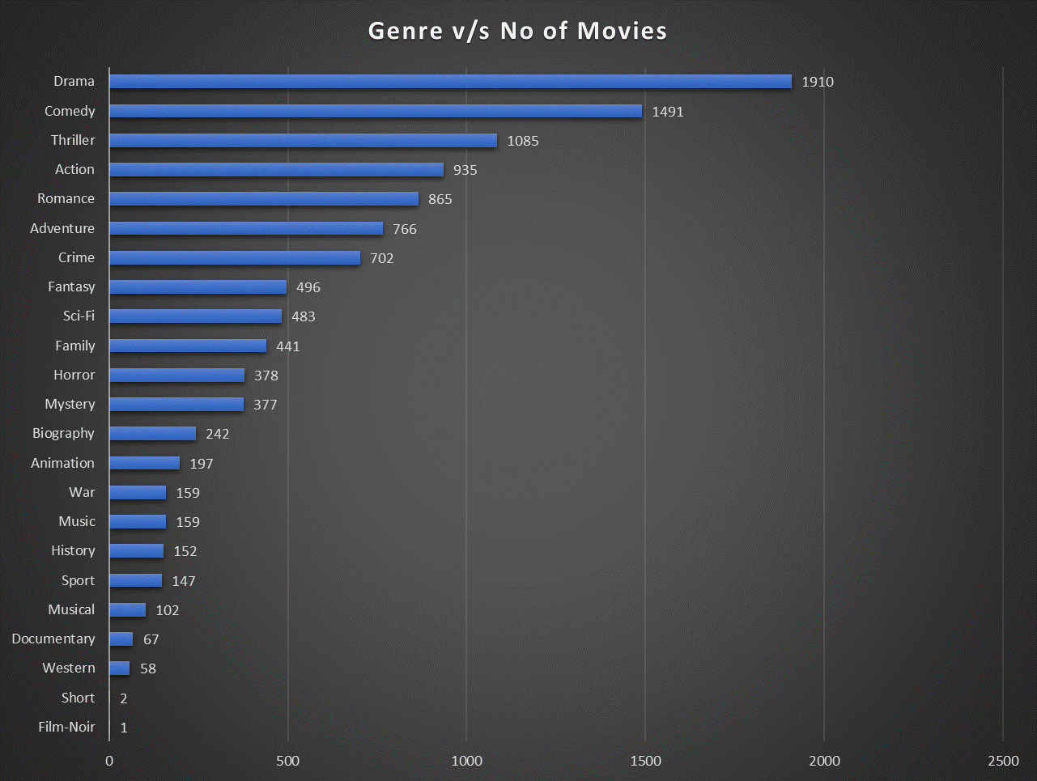
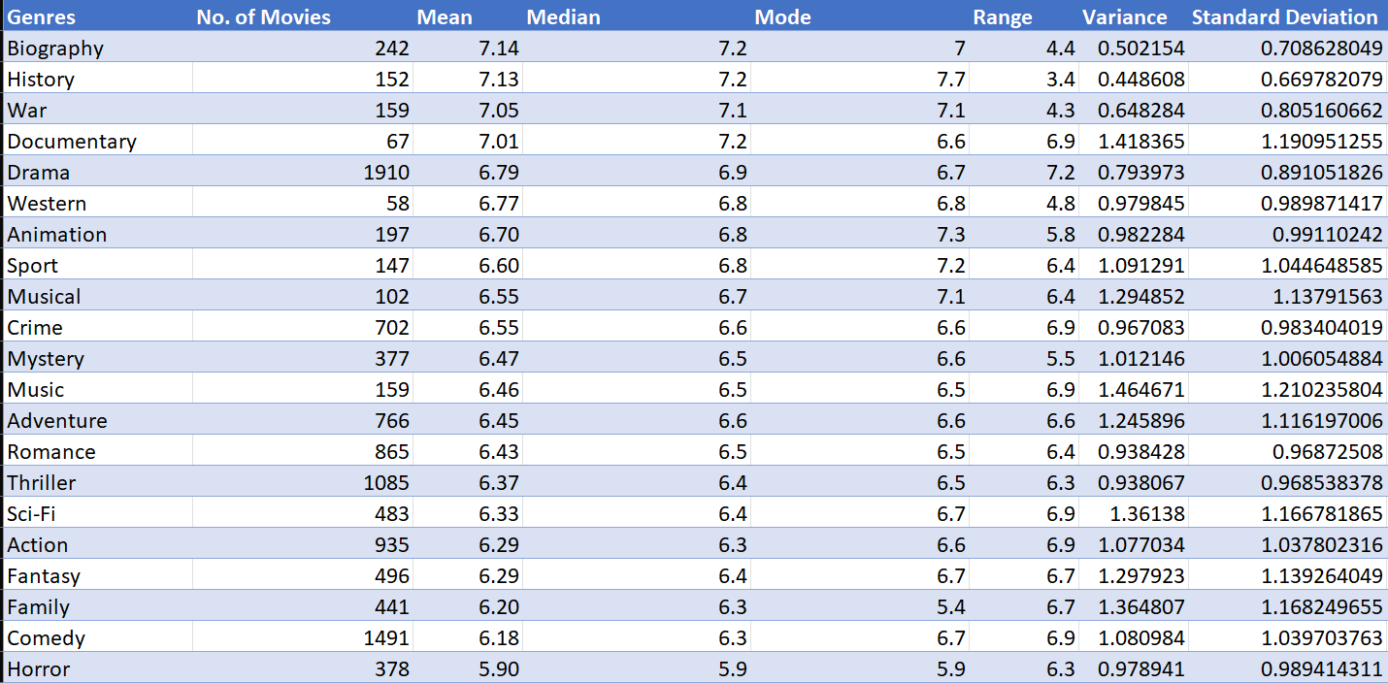
A. Movie Genre Analysis
Task : Determine the most common genres of movies in the dataset. Then, for each genre, calculate descriptive
statistics (mean, median, mode, range, variance, standard deviation) of the IMDB scores.

Slide 6
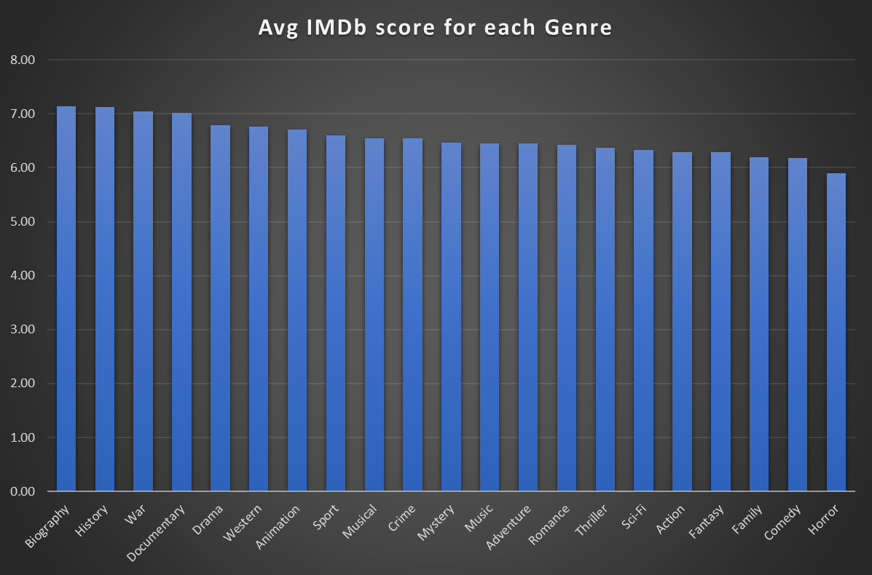
Biography, History and War genres have relatively higher average IMDb scores and have lower variability suggesting they are well-recieved and have consistent ratings among audiences.
The Drama genre is a widely represented genre with 1910 movies and have a moderate rating of 6.79.
Music, Documentary, Family and Sci-Fi genres have higher standard deviations indicating varied audience responses.
Genres like Adventure, Romance, Action, and Fantasy have moderate mean and median IMDb scores, suggesting consistent but not extremely high ratings.
Genres like Documentary, Drama, Western, and Animation have relatively higher ranges, indicating more variation in IMDb scores. This suggests that while some movies in these genres do very well, others might not.

Slide 7

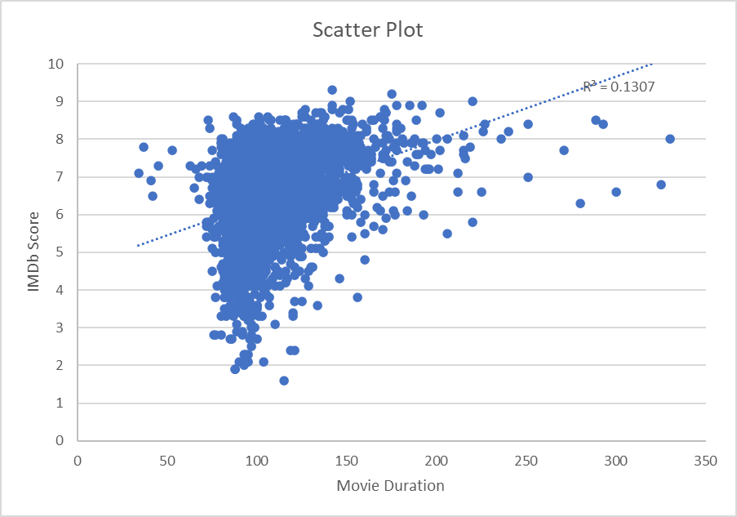
B. Movie Duration Analysis
Task : Analyze the distribution of movie durations and identify the relationship between movie duration and IMDB score.
The mean, median and standard deviation for movie durations are -

Slide 8
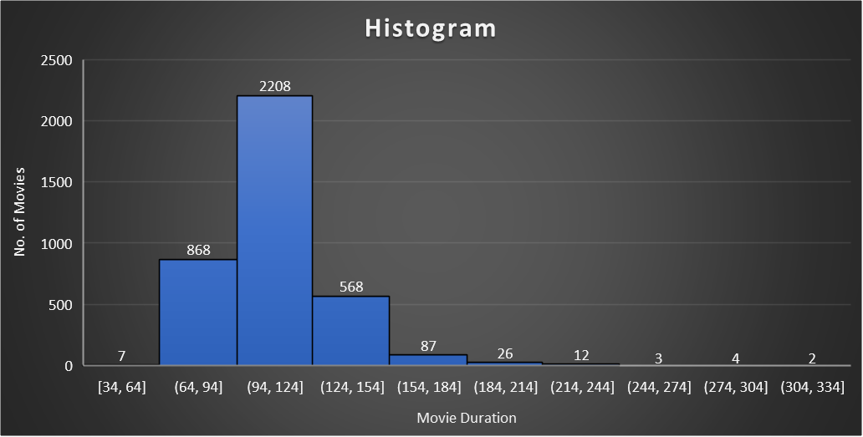
The average duration for movies are 109.8 minutes and the median value is also close, which is 105 minutes. Most movies have duration in the range of 94-124 minutes.
The positive slop in the trendline indicates a tendency for longer movies to have higher IMDb scores. However, the strength of this relationship is relatively low, as indicated by the R-squared value of 0.13.
A week relationship exists between movie duration and imdb scores.

Slide 9
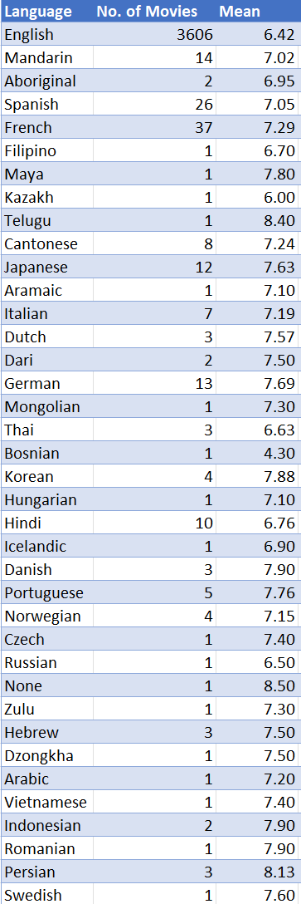
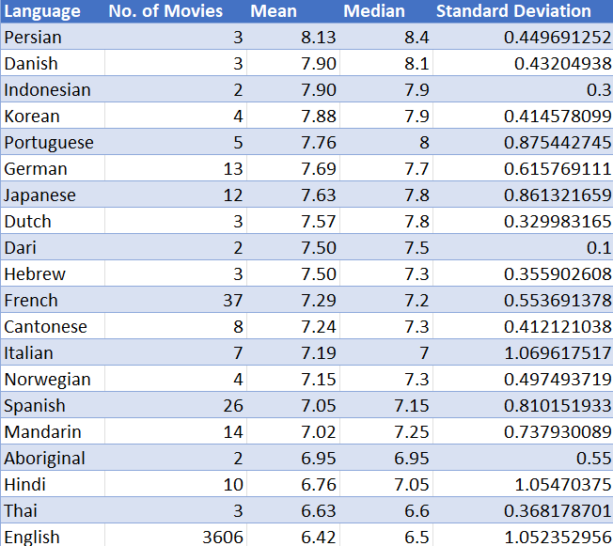
C. Language Analysis
Task : Determine the most common languages used in movies and analyze their impact on the IMDB score using
descriptive statistics.

Slide 10
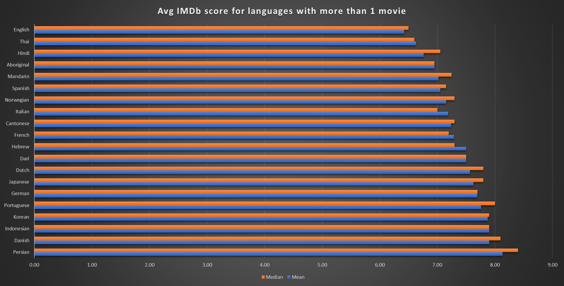
The most common language is English with a count of 3606 movies, but the average IMDb score is only 6.42 due to varied reception.
Among the languages with more than one movie count, persian language has an average score of 8.13.
Persian, Danish, Indonesian and Korean languages have good IMDb scores with less standard deviation indicating that movies in these languages have consistent ratings and less variability among audiences
Languages like Italian, Hindi, English have higher standard deviation indicating that they have a diverse audience response and wide range of ratings.

Slide 11
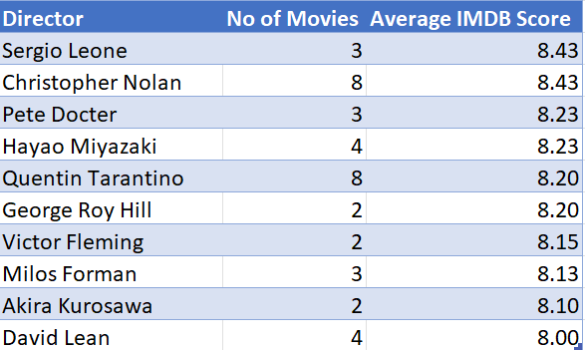
D. Director Analysis
Task : Identify the top directors based on their average IMDB score and analyze their contribution to the success of movies
using percentile calculations.
Top 10 directors based on their average IMDb score (more than one movie directed) -

Slide 12
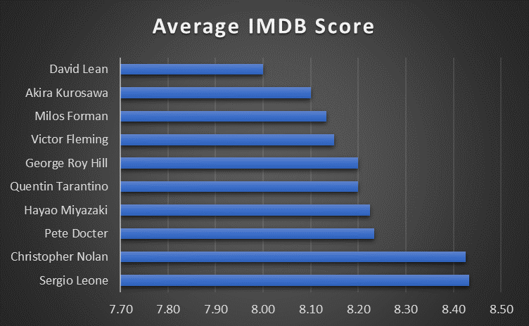
Sergio Leone and Christopher Nolan are the top directors with an average IMDb score of 8.43.
The 90th percentile for overall IMDb scores is 7.7 and that of top directors is 8.42.
The average IMDb scores of top directors range from 8-8.43, which is well above 7.7. This indicates that these director’s movies consistently achieve higher IMDb scores.

Slide 13
E. Budget Analysis
Task : Analyze the correlation between movie budgets and gross earnings, and identify the movies with the highest
profit margin.
The movie with highest profit margin is Avatar.
The correlation coefficient between movie budgets and gross earnings is 0.223. It indicates a relatively weak positive correlation.
As the correlation coefficient is closer to 0, it suggests that changes in gross earnings are not strongly dependent on movie budgets.

Slide 14
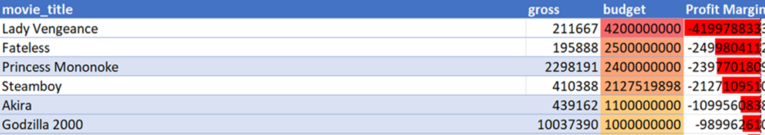
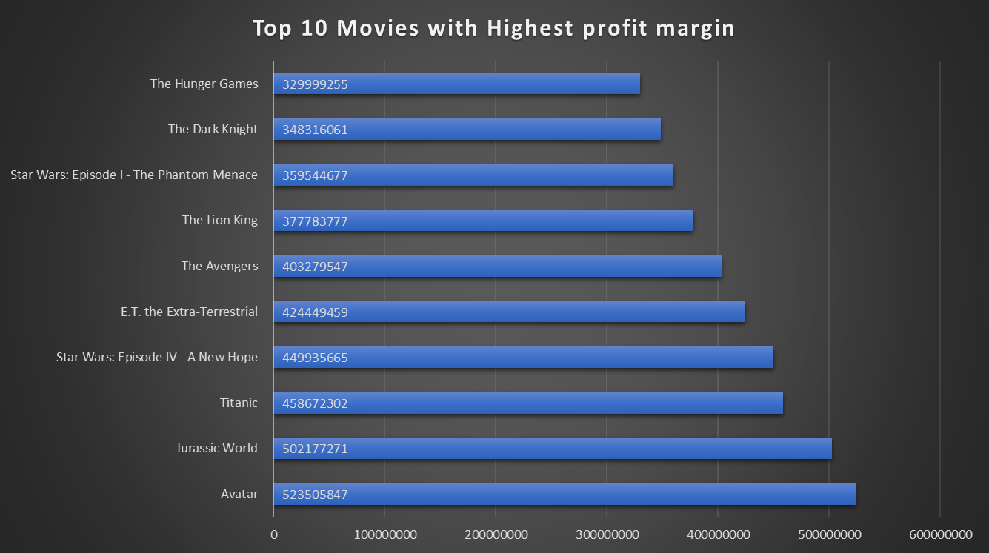
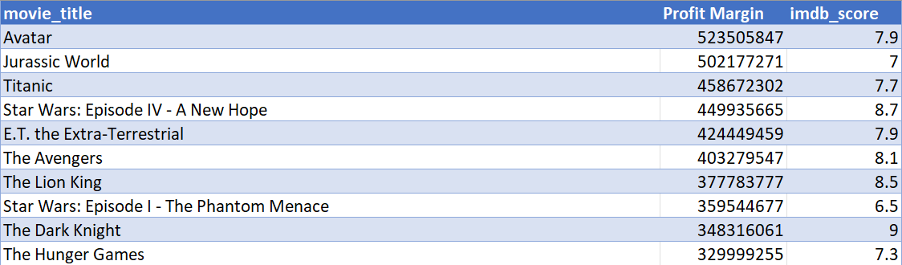
But it can be found that huge loss movies are mostly high budget movies.
The Dark Knight is the highest rated among top profited movies with an IMDb score of 9.0.

Slide 15
INSIGHTS
The key insights derived from the analysis are:
Drama, Comedy, Action and Thriller are the most common movie genres and among all the genres Drama and documentaries have higher IMDb scores. Genres like Action, Adventure and Fantasy have higher variability in scores.
Movies with duration of 100 – 150 minutes have decent IMDb scores making it an optimal range of duration, and extremely short or long movies might receive lower ratings.
Languages like Persian and Danish have an average IMDb score of above 8 and English despite having most movies has a relatively lower IMDb score.
Directors mentioned in the top 10 like Sergio Leone and Christopher Nolan have high average IMDb ratings and they maintain IMDb scores above the 90th percentile, having consistent success.
There’s a weak positive correlation between Budget and gross earnings suggesting that high budget does not always lead to high gross earnings.
Profitability can be accounted beyond budget and depends on various other factors like marketing, storytelling and wide audience reception.

Slide 16
RESULTS
The Insights derived from the project can be useful for stakeholders to make informed decisions and prepare best strategies to make a film with higher IMDb scores as well as profit margins.
The analysation was done on various factors like genre, language, duration, director and budget which are key to the success of a movie.
In summary, this project helped to extract meaningful information's from raw data to provide insights and better understanding of various factors affecting movie ratings. It helped to understand how data analysis can be applied to any industry.
File link - https://docs.google.com/spreadsheets/d/1kimPR3z-r74DmB35rsnifRImzv27mDf5/edit?usp=sharing&ouid=113891162099459296915&rtpof=true&sd=true

